Slide 1
RBMs for Energy Estimation

Slide 2
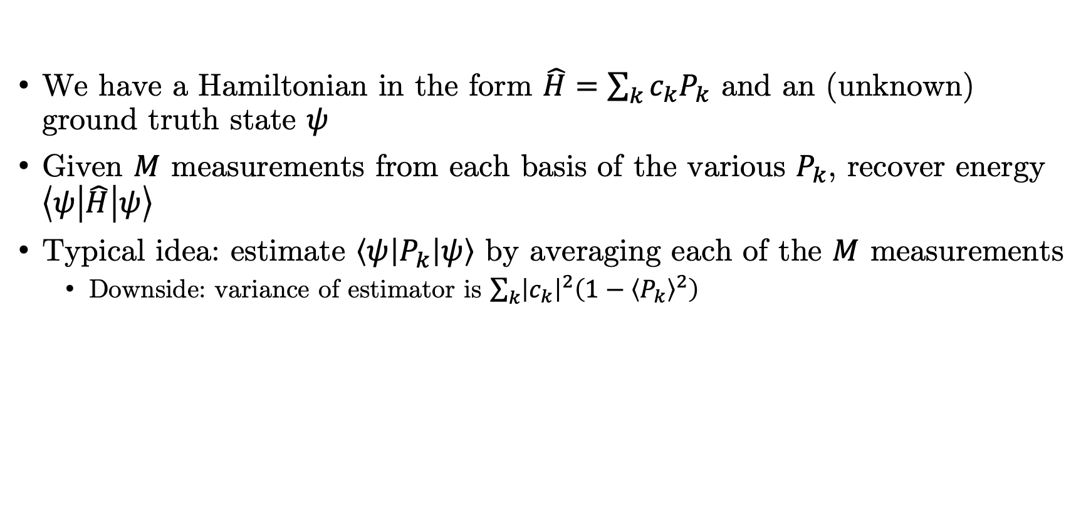
Introduction
We have a Hamiltonian in the form $\hat{H}=\sum_{k}{c_{k}P_{k}}$ and an (unknown) ground truth state $ψ$
Given $M$ measurements from each basis of the various $P_{k}$, recover energy $\left\langle ψ\left|\hat{H}\right|ψ\right\rangle$
Typical idea: estimate $\left\langle ψ\left|P_{k}\right|ψ\right\rangle$ by averaging each of the $M$ measurements
Downside: variance of estimator is $\sum_{k}{{\left|c_{k}\right|}^{2}\left(1−{\left\langle P_{k}\right\rangle }^{2}\right)}$

Slide 3
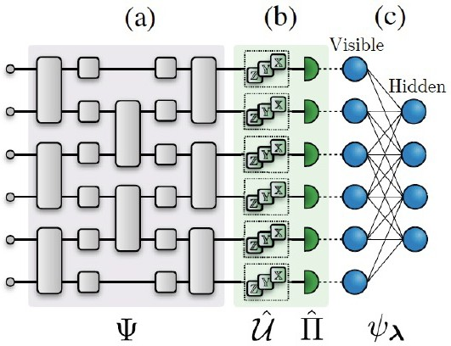
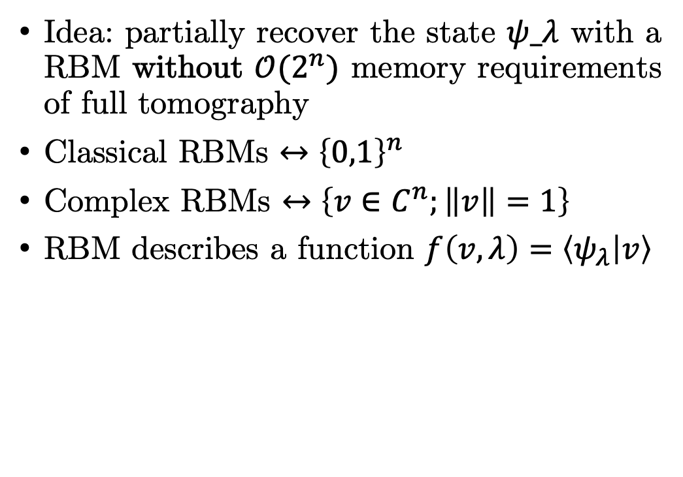
Restricted Boltzmann Machines
Idea: partially recover the state $ψ_λ$ with a RBM without $𝒪(2^{n})$ memory requirements of full tomography
Classical RBMs $↔{\left\{0,1\right\}}^{n}$
Complex RBMs $↔\left\{v∈C^{n};\left\|v\right\|=1\right\}$
RBM describes a function $f\left(v,λ\right)=\left\langle ψ_{λ} | v\right\rangle$

Slide 4
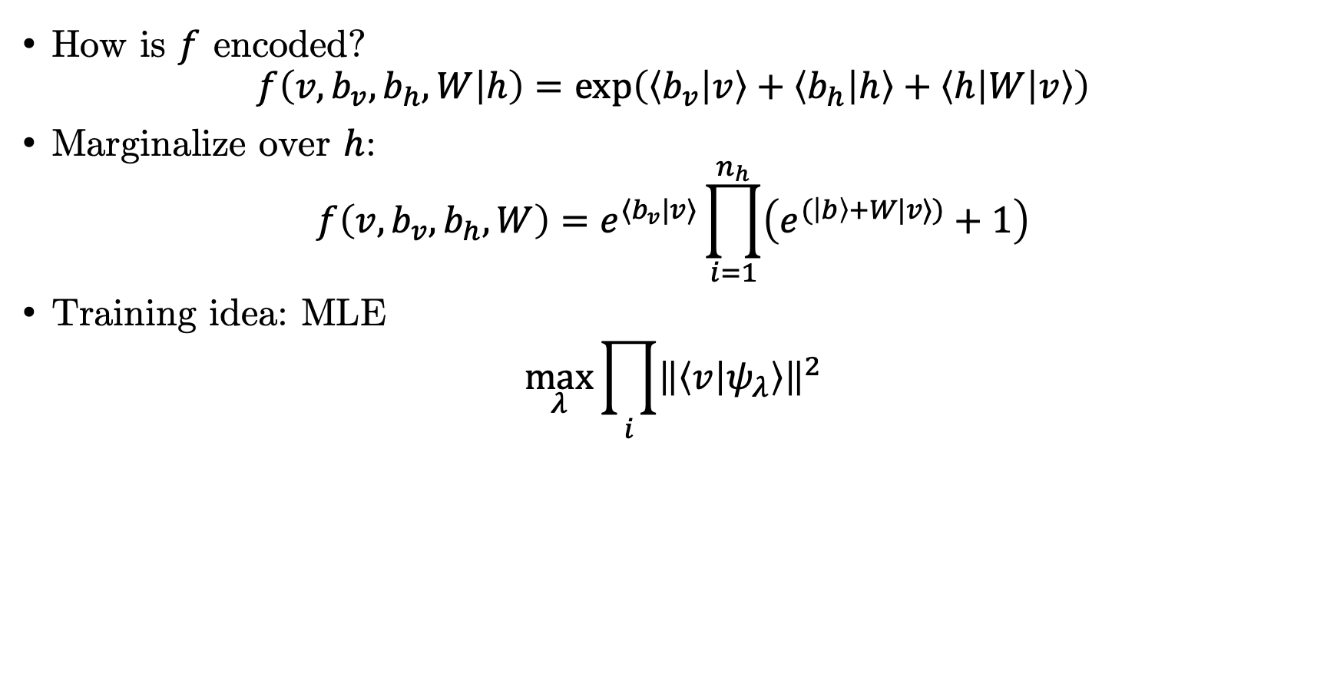
Restricted Boltzmann Machines
How is $f$ encoded?
$$f\left(v,b_{v},b_{h},W | h\right)=\exp\left(\left\langle b_{v} | v\right\rangle +\left\langle b_{h} | h\right\rangle +\left\langle h\left|W\right|v\right\rangle \right)$$
Marginalize over $h$:
$$f\left(v,b_{v},b_{h},W\right)=e^{⟨b_{v}|v⟩}\prod_{i=1}^{n_{h}}{\left(e^{(\left|b\right\rangle +W|v⟩)}+1\right)}$$
Training idea: MLE
$$\max_{λ}{\prod_{i}{{\left\|\left\langle v | ψ_{λ}\right\rangle \right\|}^{2}}}$$

Slide 5
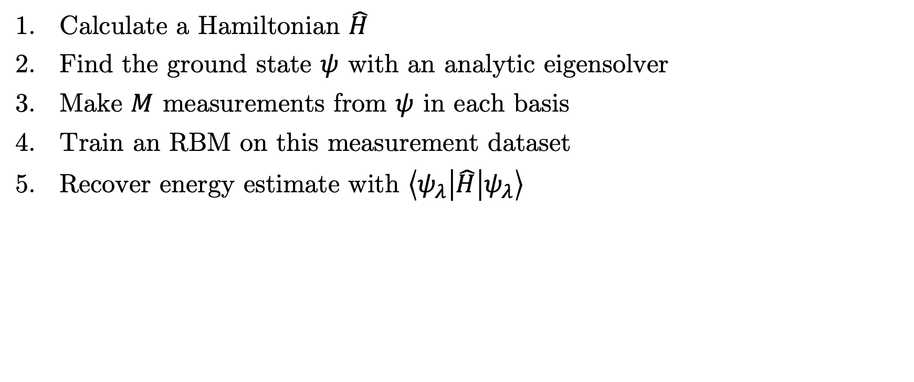
Procedure
Calculate a Hamiltonian $\hat{H}$
Find the ground state $ψ$ with an analytic eigensolver
Make $M$ measurements from $ψ$ in each basis
Train an RBM on this measurement dataset
Recover energy estimate with $\left\langle ψ_{λ}\left|\hat{H}\right|ψ_{λ}\right\rangle$

Slide 6

Results
Significant reduction in variance, at the cost of a nonzero bias
Molecule | Basis | 𝑵 | 𝑲 | Groups | Variance reduction
H2 | STO-3G | 2 | 5 | 2 | 30
LiH | STO-3G | 4 | 100 | 25 | 150
BeH2 | STO-3G | 6 | 95 | 24 | 50
H2 | 6-31G | 8 | 185 | 34 | 100

Slide 7
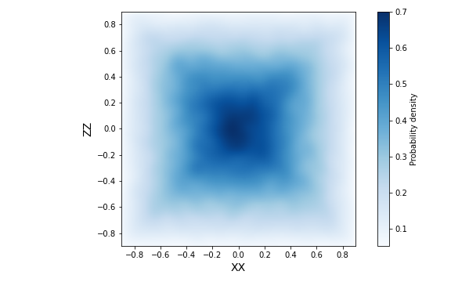

Explanation
Simplest case: correlation between terms like ZZ and XX: $ρ\left(\left|XX\right|,\left|ZZ\right|\right)=0.35$
Correlations not captured by averaging results from the two families independently
RBM incorporates the entire dataset at once, and is therefore able to capture dependencies between Pauli terms

